Slide 1
Testing of Hypothesis
Dr. AKHIL CHILWAL
Teaching Assistant & Data Analyst
G.B.P.U.A. & T., Pantnagar
Mo. 9411883705

Slide 2
Introduction
The primary objective of statistical analysis is to use data from a sample to make inferences about the population from which the sample was drawn.

Slide 3
Hypothesis Testing
What is Hypothesis?
“A hypothesis is an educated prediction that can be tested” (study.com).
“A hypothesis is a proposed explanation for a phenomenon” (Wikipedia).
“A hypothesis is used to define the relationship between two variables” (Oxford dictionary).
“A supposition or proposed explanation made on the basis of limited evidence as a starting point for further investigation” (Walpole).

Slide 4
Testing of Hypothesis
Testing of Hypothesis:
In hypothesis testing, we decide whether to accept or reject a particular value of a set, of particular values of a parameter or those of several parameters. It is seen that, although the exact value of a parameter may be unknown, there is often same idea about the true value. The data collected from samples helps us in rejecting or accepting our hypothesis. In other words, in dealing with problems of hypothesis testing, we try to arrive at a right decision about a pre-stated hypothesis.
Definition:
A test of a statistical hypothesis is a two action decision problem after the experimental sample values have been obtained, the two–actions being the acceptance or rejection of the hypothesis.

Slide 5
Statistical Hypothesis:
If the hypothesis is stated in terms of population parameters (such as mean and variance), the hypothesis is called statistical hypothesis.
Example: To determine whether the wages of men and women are equal.
A product in the market is of standard quality.
Whether a particular medicine is effective to cure a disease.
Parametric Hypothesis:
A statistical hypothesis which refers only the value of unknown parameters of probability Distribution whose form is known is called a parametric hypothesis.
Example: if then
is a parametric hypothesis

Slide 6
Null Hypothesis: H₀
The null hypothesis (denoted by H₀) is a statement that the value of a population parameter (such as proportion, mean, or standard deviation) is equal to some claimed value.
We test the null hypothesis directly.
Either reject H₀ or fail to reject H₀.

Slide 7
Example:
H_{o} : µ=5
The above statement is null hypothesis stating that the population mean is equal to 5.
Another example can be taken to explain this. Suppose a doctor has to compare the decease in blood pressure when drugs A & B are used. Suppose A & B follow distribution with mean µ_{A} and µ_{B} ,then
H_{o} : µ_{A} = µ_{B}

Slide 8
Alternative Hypothesis: H₁
The alternative hypothesis (denoted by H₁ or H_{a} or H_{A}) is the statement that the parameter has a value that somehow differs from the Null Hypothesis.
The symbolic form of the alternative hypothesis must use one of these symbols: ≠, <, >.

Slide 9
Types of Alternative Hypothesis
We have two kinds of alternative hypothesis:-
(a) One sided alternative hypothesis
(b) Two sided alternative hypothesis
The test related to (a) is called as ‘one – tailed’ test and those related to (b) are called as ‘two tailed’ tests.

Slide 10
H_{o} : µ = µ₀
Then
H₁ : µ < µ₀ or H₁ : µ > µ₀
One sided alternative hypothesis
H₁ : µ ≠ µ₀
Two sided alternative hypothesis

Slide 11
Note about Forming Your Own Claims (Hypotheses)
If you are conducting a study and want to use a hypothesis test to support your claim, the claim must be worded so that it becomes the alternative hypothesis.

Slide 12
Test Statistic
The test statistic is a value used in making a decision about the null hypothesis, and is found by converting the sample statistic to a score with the assumption that the null hypothesis is true.
The statistic that is compared with the parameter in the null hypothesis is called the test statistic.
Test statistic for mean

Slide 13
Critical Region
The critical region (or rejection region) is the set of all values of the test statistic that cause us to reject the null hypothesis.
Acceptance and rejection regions in case of a two-tailed test with 5% significance level.

Slide 14
Significance Level
The significance level (denoted by α) is the probability that the test statistic will fall in the critical region when the null hypothesis is actually true. Common choices for α are 0.05, 0.01, and 0.10.

Slide 15
Critical Value
A critical value is any value that separates the critical region (where we reject the null hypothesis) from the values of the test statistic that do not lead to rejection of the null hypothesis. The critical values depend on the nature of the null hypothesis, the sampling distribution that applies, and the significance level α.

Slide 16
Two-tailed, Right-tailed, Left-tailed Tests
The tails in a distribution are the extreme regions bounded by critical values.

Slide 17
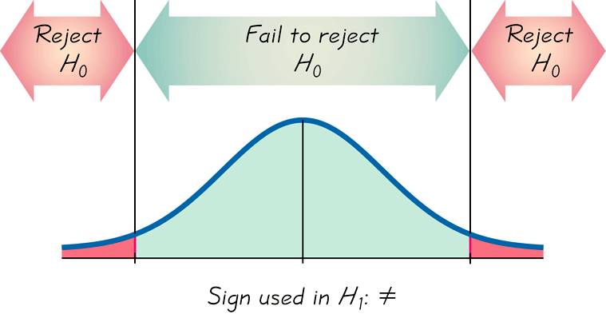
Two-tailed Test
H₀: =
H₁: ≠
α is divided equally between the two tails of the critical region
Means less than or greater than

Slide 18
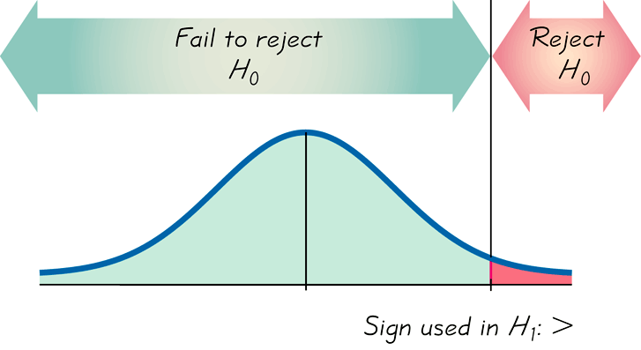
Right-tailed Test
H₀: =
H₁: >
Points Right

Slide 19
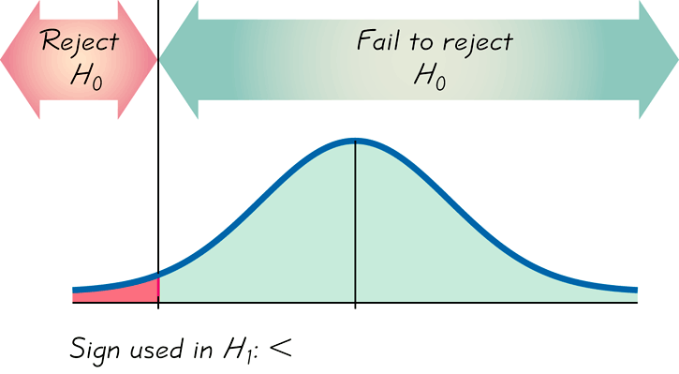
Left-tailed Test
H₀: =
H₁: <
Points Left

Slide 20
P-Value
The P-value (or p-value or probability value) is the probability of getting a value of the test statistic that is at least as extreme as the one representing the sample data, assuming that the null hypothesis is true. The null hypothesis is rejected if the P-value is very small, such as 0.05 or less.

Slide 21

Two-tailed Test
If the alternative hypothesis contains the not-equal-to symbol (≠), the hypothesis test is a two-tailed test. In a two-tailed test, each tail has an area of P.
H₀: μ = k
H_{a}: μ ≠ k
P is twice the area to the right of the positive test statistic.
P is twice the area to the left of the negative test statistic.
-3
-2
-1
0
1
2
3
Test statistic
Test statistic

Slide 22
Right-tailed Test
If the alternative hypothesis contains the greater-than symbol (>), the hypothesis test is a right-tailed test.
H₀: μ = k
H_{a}: μ > k
P is the area to the right of the test statistic.
-3
-2
-1
0
1
2
3
Test statistic

Slide 23
Left-tailed Test
If the alternative hypothesis contains the less-than inequality symbol (<), the hypothesis test is a left-tailed test.
H₀: μ = k
H_{a}: μ < k
P is the area to the left of the test statistic.
-3
-2
-1
0
1
2
3
Test statistic

Slide 24
Making a Decision
We always test the null hypothesis. The initial conclusion will always be one of the following:
1. Reject the null hypothesis.
2. Fail to reject the null hypothesis.

Slide 25
Decision Criterion
Traditional method
Reject H₀ if the test statistic falls within the critical region.
Fail to reject H₀ if the test statistic does not fall within the critical region.

Slide 26
Decision Criterion
P-value method
Reject H₀ if the P-value ≤ α (where α is the significance level, such as 0.05).
Accept H₀ if the P-value > α.

Slide 27
Decision Criterion
Confidence Intervals
Because a confidence interval estimate of a population parameter contains the likely values of that parameter, reject a claim that the population parameter has a value that is not included in the confidence interval.

Slide 28
Type I Error
A Type I error is the mistake of rejecting the null hypothesis when it is true.
The symbol α (alpha) is used to represent the probability of a type I error.

Slide 29
Type II Error
A Type II error is the mistake of failing to reject the null hypothesis when it is false.
The symbol β (beta) is used to represent the probability of a type II error.

Slide 30
There may be four possible situations that arise in any test procedure which have been summaries are given below:
Actual Truth of H₀
Decision
H₀ is true
H₀ is false
Accept H₀
Correct Decision
Type II Error
Reject H₀
Type I Error
Correct Decision

Slide 31
Controlling Type I & Type II Errors
For any fixed α, an increase in the sample size n will cause a decrease in β.
For any fixed sample size n, a decrease in α will cause an increase in β. Conversely, an increase in α will cause a decrease in β.
To decrease both α and β, increase the sample size.

Slide 32
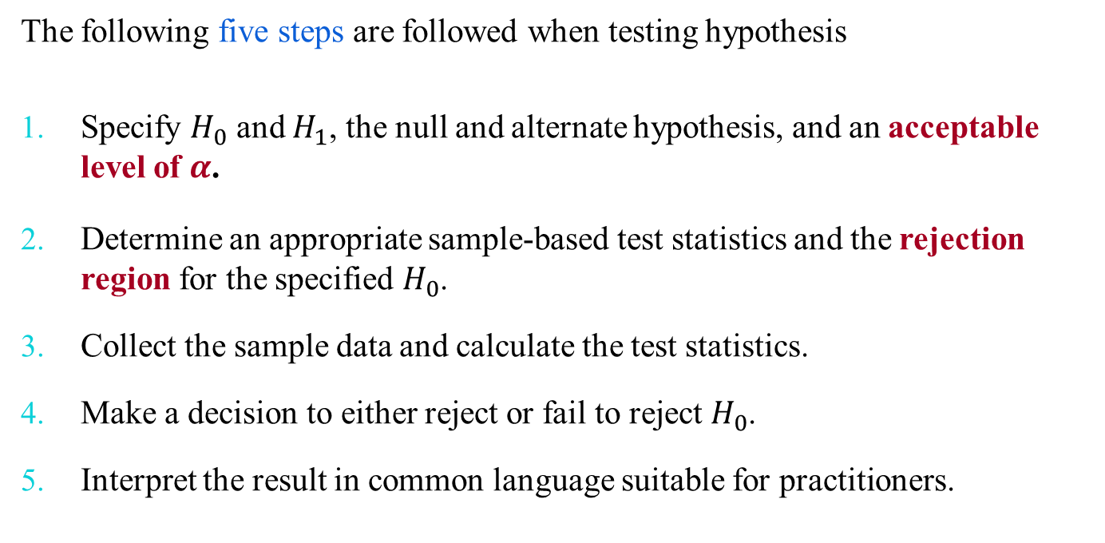
Hypothesis Testing Procedures

Slide 33
Interpreting a Decision
Example:
H₀: (Claim) A cigarette manufacturer claims that less than one-eighth of the US adult population smokes cigarettes.
If H₀ is rejected, you should conclude “there is sufficient evidence to indicate that the manufacturer’s claim is false.”
If you fail to reject H₀, you should conclude “there is not sufficient evidence to indicate that the manufacturer’s claim is false.”

Slide 34
Thank You

